Slide 1
Ge AI-Based Data Profiling
By SmartTech Team

Slide 2
Problem Statement/Use Case
Challenge: Develop Gen AI-powered data profiling solution that can:
Extract, interpret and refine regulatory reporting instructions to identify key data validation requirements .
Automatically generate profiles rules based on allowable values and cross-relation.
Generate executable validation code .
Suggest remediation actions for flagged transactions/observations .

Slide 3
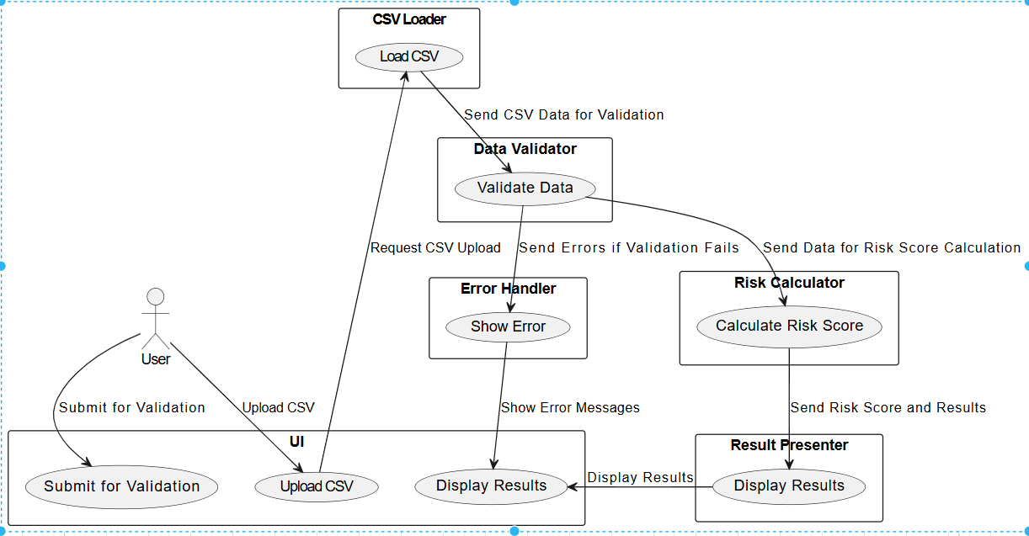
Architecture Diagram:

Slide 4
Provided Solution
1) Implemented a UI platform provides capabilities for user to upload any file(We are using currently CVS) .
2) User can upload the CVS file and request for validation .
3) System can validate the details and identify the Errors and Remediations actions .
4) Applying all profiling rules.

Slide 5
Play Book
We generated Python based application.
This component will support for cloud and non-cloud deployments .

Slide 6
Technology used:
1) Transformers
2) Pandas
3) Scikit-learn
4) Openai
5) jinja2
6) GPT-2

Slide 7
Thank You

